Slide 1

NEBRASKA EMERGENCY MANAGEMENT AGENCY
DR- 4868
Public Assistance
Notes:
This is the Applicant Briefing for DR-4778-NE

Slide 2
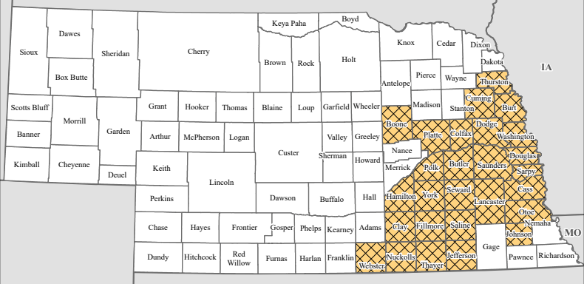

PUBLIC ASSISTANCE AL # 97.036
DR-4868
INCIDENT PERIOD: March 18-19, 2025
SIGNED BY THE PRESIDENT: May 21, 2025
(Severe Winter Storm and Straight-line Winds)
Boone, Burt, Butler, Cass, Clay, Colfax, Cuming, Dodge, Douglas, Fillmore, Hamilton, Jefferson, Johnson, Lancaster, Nuckolls, Otoe, Platte, Polk, Saline, Sarpy, Saunders, Seward, Thayer, Thurston, Washington, Webster, and York Counties
Notes:
The declaration date is the date it was signed by the president. This is a very important date to remember, as many deadlines we will encounter are attached to this date. The PA eligible area consists of the 6 counties listed.

Slide 3
Public Assistance
Public Assistance is a voluntary FEMA program designed as a reimbursement program for eligible Applicants who have sustained damages or costs that are related to the response to, and recovery from, certain incidents as declared under the authority of the Stafford Act.
Public Assistance is for damages to public infrastructure and facilities, not for private homes and businesses.
Eligible Public Assistance projects are paid out with a 75% Federal Share of eligible, obligated costs.
The State of Nebraska will provide a cost share of up to half the obligated non-federal share of the project total based on documented costs.
Full documentation must be submitted and validated for cost share to be paid
Not all applicants are eligible for the State cost share

Slide 4
Program Authorities and Governing Documents
State Statute 81-829, 36 50 75
Stafford Act
Disaster Mitigation Act of 2000
Disaster Recovery and Reform Act of 2018 (DRRA)
44 Code of Federal Regulations
2 Code of Federal Regulations
Public Assistance Program and Policy Guide, Version 5 (PAPPG)
Governor’s Emergency Fund Guidelines for Public Officials
Nebraska Emergency Management Act

Slide 5
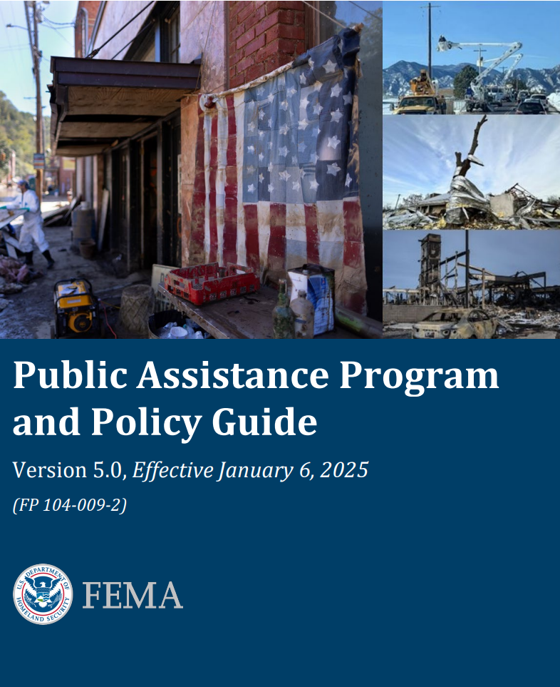
Public Assistance Program and Policy Guide (PAPPG)
Combines all Public Assistance Policy into a single volume and provides an overview of the PA program implementation process with links to other publications and documents that provide additional process details.
This disaster will fall under January 6, 2025 guidance (Version 5)
Pay attention to updates, as noted on pages 21-23
Policy updates are made from time to time, and are posted on FEMA.gov

Slide 6
Time Limits for Aid Request
Applying for a PA Grant : 30 days from disaster declaration
Request for Public Assistance (RPA) is done by the Applicant in Grants Portal by June 20, 2025
Damage Identification
Applicant must identify all incident-related damages within 60 days of the Recovery Scoping Meeting
On Damage Inventory Sheet on Grants Portal
Damage identification should include all facility damage, debris quantities, and emergency protective measures to address immediate threats being claimed by the applicant.
Damages not identified and submitted to FEMA within the regulatory time limits will not be eligible.
Notes:
RPA deadline extended from June 2 to June 28

Slide 7
General Program Eligibility Building Blocks
Cost
Facility
Applicant
Work

Slide 8
Applicant Eligibility PAPPG v.5 pages 44-58
State Government
DOT, DNR, etc.
Local Government
County Government
Cities/Towns/Villages/Townships
School districts
Tribal Government
Public Utilities
Power Districts, Public Works, etc.
Natural Resources Districts
Certain types of private non-profit organizations
Critical Services
Essential/Non-Critical Services
Cost
Facility
Applicant
Work

Slide 9
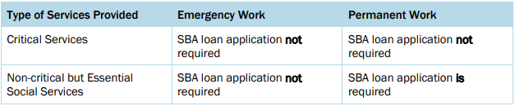
Private Non-Profit Requirements PAPPG v.5 pages 46-58
Only certain PNPs are eligible applicants.
For an PNP to demonstrate eligibility, the PNP must provide the following documentation:
Tax Exempt Letter, 501(c), (d), or (e) IRS designation
Or a Documentation from the State substantiating it is a non-revenue producing, nonprofit entity, organized or doing business under State law.
Articles of Incorporation, Organizational Charter, and/or Organizational By-Laws
These documents will need to be uploaded to Grants Portal prior to receiving approval of the Requests for Public Assistance (RPA)
The PNP must demonstrate that they provide either Critical Services or Essential Non-Critical Services

Slide 10
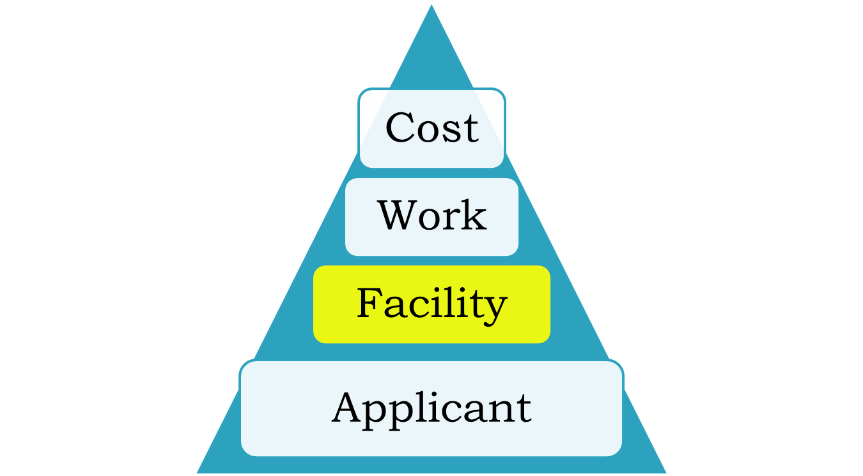
Facility Eligibility PAPPG v.5 pages 59-74
Facility:
Buildings, works, systems, or equipment owned by an eligible applicant
To be eligible:
Damage/Costs must be disaster related
Damage must be properly identified and documented within the allotted time frame
Facility must be the legal responsibility of an eligible applicant
Facility must have been in active use at the time of the disaster
Facility must be in the designated disaster area
If the facility is under the specific authority of another Federal agency, FEMA does not provide funding to restore the facility.
Notes:
We frequently use the term “Damage.” That does not necessarily mean that some aspect of the facility is physically damaged. Damages, especially for this declared event, can simply mean additional event-related costs.

Slide 11
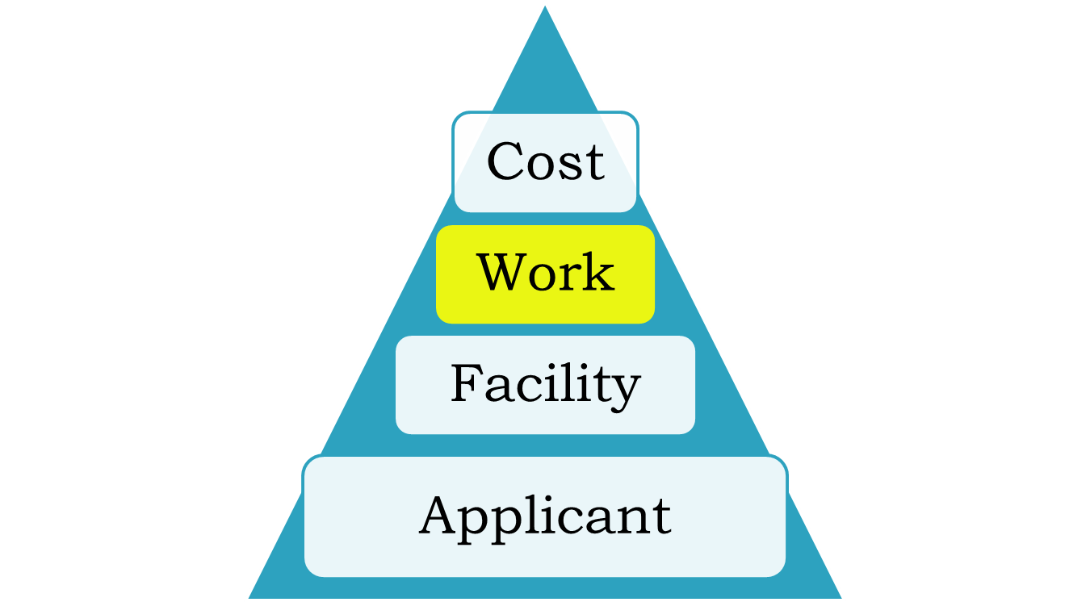
Work Eligibility PAPPG v.5 pages 59-74
To be eligible:
Work must be required as a result of the declared incident
Be located within the designated area
Be the legal responsibility of an eligible applicant
Permanent Work (Categories C–G) must restore a facility to its pre-disaster design (size and capacity) and function in accordance with applicable codes and standards.
Note: work must be reasonable, completed in a timely manner, and comply with all Federal, State, and local laws and regulations

Slide 12
Work Eligibility- Potential Concerns
All work done must follow all applicable Federal, State, and Local Environmental and Historic Preservation (EHP) laws.
Permits, permissions, and/or concurrence statements may need to be obtained from various Federal, State, and Local agencies, including, but not limited to:
US Army Corps of Engineers (USACE)
US Fish and Wildlife Service (USFWS)
Nebraska State Historic Preservation Office (SHPO)
Nebraska Department of Environment and Energy (NDEE)
Nebraska Department of Natural Resources (NDNR)
Failure to comply with these policies prior to starting work may lead to loss of funding.
Damages that cannot be proven as being caused by the incident will be considered ineligible.
Maintenance records, inspection reports, and third-party sourced images and documents may be referenced to make those determinations.
Damages not properly identified within the guidelines established by regulation and policy will not be eligible.
Notes:
It is extremely important that all environmental and historic preservation rules are followed. When a project is obligated, the applicant will also receive a REC Report, that’s a Record of Environmental Consideration. That will outline the environmental policies that must be followed.

Slide 13
Work Eligibility- Potential Concerns
All work must be done according to the FEMA-Approved and obligated Scope of Work (SOW)
Work completed outside of the approved SOW will not be eligible for reimbursement and may result in partial or complete deobligation of funds
Failure to complete the approved work may result in partial or complete deobligation of funds
If you wish to do work other than what is in the FEMA-Approved Scope of Work, you must get approval from FEMA, through NEMA, before work is started.
Potential ways to do this are Alternate Projects and Improved Projects.

Slide 14
Cost Eligibility PAPPG v.5 pages 75- 114
FEMA evaluates the eligibility of all submitted costs
To be eligible the costs must be:
Directly tied to the performance of eligible work
Adequately documented
Reduced by all applicable credits, such as insurance proceeds and salvage values
Authorized and not prohibited under Federal, State, Territorial, Tribal or local government laws or regulations
Consistent with applicant’s internal policies, regulations, and procedures that apply uniformly to both federal awards and other activities of the applicant
Necessary and reasonable to accomplish the work properly and effectively.
Cost
Facility
Applicant
Work

Slide 15
Potentially Eligible Additional Costs: Hazard Mitigation (406) PAPPG v.5 pages 178-184; 314-318
Hazard mitigation is any sustained action taken to reduce or eliminate long-term risk to people and property from natural hazards and their effects. FEMA has authority to provide PA funding for cost-effective hazard mitigation measures for facilities damaged by the incident.
To be eligible for PA funding, the mitigation measures must directly reduce the potential of future damage to the damaged portion(s) of the facility.
Applies only to the damaged elements.
Program allows for an additional 15% of costs on most permanent work projects, up to an additional 100% of costs for some. (Projects still paid at a 75% Federal Share)
Eligibility is based on certain benefit/cost ratio limits
Hazard Mitigation must be approved by FEMA before starting work in order to be eligible for reimbursement.

Slide 16
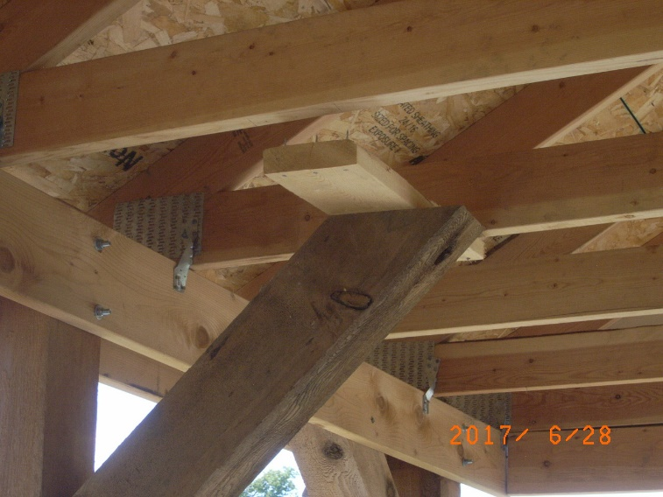
Potentially Eligible Additional Costs: Codes and Standards Upgrades PAPPG v.5 pages 168-178
Upgrades and increased costs required due to Codes and Standards that apply to a facility may also be eligible for public assistance funding as part of eligible restoration projects.
For the cost of an upgrade to be eligible, the code or standard must be in effect before the disaster takes place, it must have been formally adopted, and it must be enforced and uniformly applied.
Codes and Standards upgrades must be approved by FEMA before starting work in order to be eligible.

Slide 17
Special Considerations
Issues which could affect the scope of work and funding of a project:
Insurance and National Flood Insurance Program
Floodplain Management
Hazard Mitigation
Environmental preservation
Historic preservation and cultural resources
Some projects may be written to include a requirement that the applicant obtain and maintain insurance on a facility following completion of the eligible repairs.
Failure to do so may result in denial or deobligation of PA funds related to noncompliance
NOTE: You must notify NEMA PA staff of any changes to the Scope of Work prior to starting work or risk loss of funding for the project.

Slide 18
Duplication of Benefits PAPPG v.5 pages 113-118
FEMA is legally prohibited from duplicating benefits from other sources.
Duplication of benefits can result in the reduction in funding to eligible costs, partial de-obligation of funds, or total de-obligation of funds.
FEMA cannot provide funding that duplicates:
Insurance proceeds
Actual proceeds, if known when the project is being developed, or
Anticipated proceeds based on FEMA’s reading of the insurance documents
Non-Federal Grants
Ear-marked Cash Donations
Other Federal Awards
Funding Between FEMA Programs

Slide 19
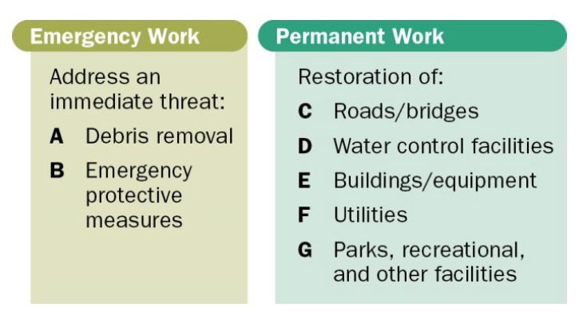
Categories of Work
Notes:
At a minimum, work must meet each of the following three general criteria to be eligible:
• Be required as a result of the declared incident;
• Be located within the designated area, with the exception of sheltering and evacuation activities; and
• Be the legal responsibility of an eligible Applicant
The Applicant is responsible for showing that work is required:
• Due to an immediate threat resulting from the declared incident (for Emergency Work); or
• To address damage caused by the declared incident.
For debris removal, the Applicant must demonstrate that the debris causing an immediate threat was generated during the declared incident period and directly by declared incident.
For temporary repairs, mold remediation, and Permanent Work, the Applicant must demonstrate that damage was caused directly by the declared incident. FEMA does not provide PA funding for repair of damage caused by:
• Deterioration
• Deferred maintenance
• The Applicant’s failure to take measures to protect a facility from further damage
Or Negligence

Slide 20
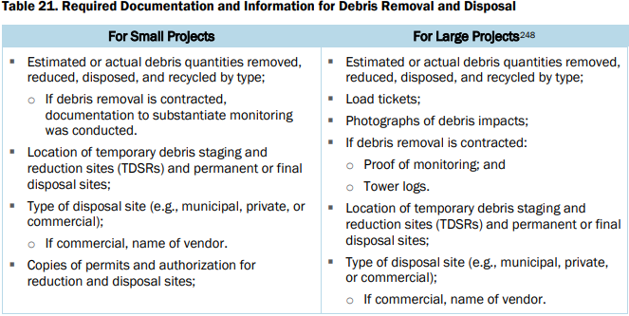
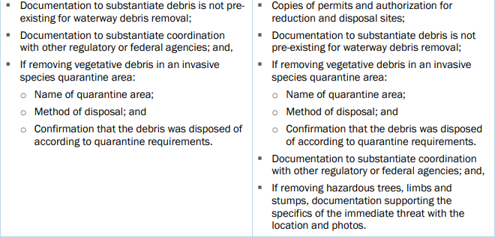
Emergency Work: Debris Removal Category A PAPPG v.5 pages 117-130
Debris removal is eligible when:
It eliminates an immediate threat to life, health, and safety
It eliminates an immediate threat of significant damage to improved property
It ensures economic recovery of the community and provides a benefit for the community-at-large
Straight-time and Overtime labor costs are eligible for reimbursement.

Slide 21
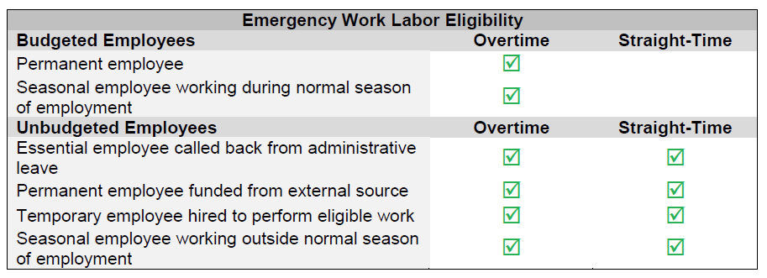
Emergency Work Category B – Emergency Protective Measures PAPPG v.5 pages 130-166
Emergency protective measures are actions taken before, during, and following a disaster to save lives, protect public health and safety, or eliminate immediate threat of significant damage to improved public and private property.
If Cat A/B Emergency Work projects are not completed within a timely manner, FEMA may determine that there was no immediate threat to life, health, safety, or improved property, and determine that the work is ineligible for reimbursement

Slide 22
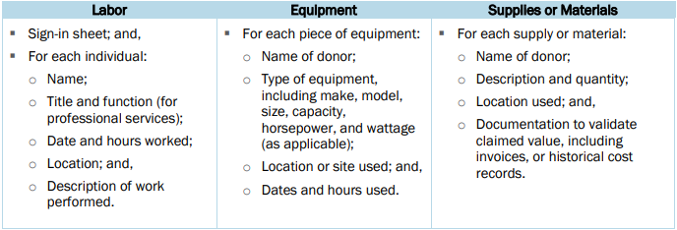
Emergency Work Donated Resources – Category B
Individuals and organizations often donate resources (equipment, supplies, materials, or labor) to assist with response activities.
FEMA prepares the donated resource project separate from the emergency work projects for the applicant’s incurred costs. FEMA does not obligate donated resources projects until after all the applicant's emergency work projects have been obligated
Volunteer labor must be well-documented (name, hours worked, work site/location, and description of work for each volunteer)
Donated equipment and materials need supporting/equivalent information.
Donated Resources Emergency Work Projects may be used to offset the non-federal cost share of other eligible emergency work (Category A&B) projects.
Notes:
If you have documentation to support a Cat B Donated Resources Project, please be sure that you communicate that to your FEMA Program Delivery Manager when they start working with you to develop projects. If you wait until after the projects are all developed and obligated, we cannot guarantee we will be able to help you add a donated resources project.

Slide 23
Permanent Work: Categories C-G PAPPG v.5 pages 167-229
Applicants may claim reimbursement for eligible costs incurred while performing eligible permanent work, including:
Force Account Labor
This includes hourly pay AND associated benefits for the applicant’s employees, for straight-time and overtime
Force Account Equipment
The cost to operate equipment owned by the applicant
Materials
The cost of materials used in the repair or replacement of an eligible facility
Contract Labor
Rented Equipment
Reimbursed according to the rental agreement

Slide 24
Project Completion Dates PAPPG v.5 pages 250-251
Time limits for project completion begin on the disaster declaration date:
Emergency work (Categories A&B) must be completed within 6 months (November 20, 2025)
Permanent work (Categories C-G) must be completed within 18 months (November 20, 2026)
For extenuating circumstances or project requirements, deadlines may be extended 6 months for emergency work and 30 months for permanent work
Time Extensions are not automatically granted by NEMA or by FEMA

Slide 25
Time Extensions PAPPG v.5 pages 159 & 250
FEMA generally considers the following to be extenuating circumstances beyond the Applicant’s control:
Permitting or EHP compliance related delays due to other agencies involved;
Environmental limitations (such as short construction window);
Inclement weather (site access prohibited or adverse impact on construction); and
Lack of availability of materials, equipment, or contractors to complete work.
FEMA generally considers the following to be circumstances within the control of the Applicant and not justifiable for a time extension:
Permitting or environmental delays due to Applicant delays in requesting permits;
Lack of funding;
Change in administration or cost accounting system; and
Compilation of cost documentation.
As we get closer to project deadlines, NEMA staff with work with applicants to obtain time extensions
Time Extension Requests submitted through Grants Portal will not be accepted

Slide 26
Documentation PAPPG v.5 page 260 & Throughout
Applicants are responsible for presenting complete documentation packages to FEMA and/or NEMA for project development and closeout, as required.
Pictures taken before, during, and after repair or clean-up are highly recommended
Please submit and maintain your documentation separated by project.
Applicants are required to maintain project files for all PA projects that contain all necessary backup information and to retain those files for five (5) years after the overall disaster has been officially closed for audit purposes. If your jurisdiction requires longer time, then you must keep it that long- minimum is 5 years.

Slide 27
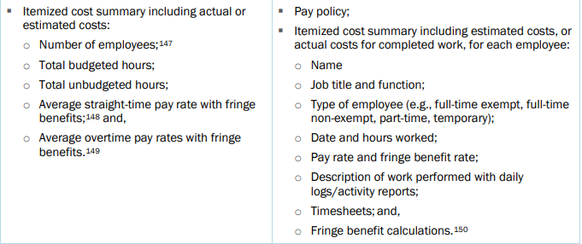
Force Account Labor PAPPG v.5 pages 59-84
FEMA refers to the applicant’s personnel as “force account”.
FEMA reimburses force account labor based on actual hourly rates plus the cost of the employees' actual fringe benefits.
FEMA calculates the fringe benefit cost based on percentage of the hourly pay rate because certain items in a benefit package are not dependent on hours worked (i.e., health insurance), the percentage for overtime is usually different than the percentage for straight-time.

Slide 28
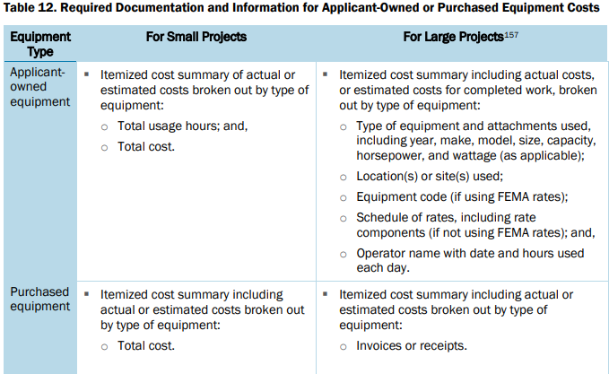
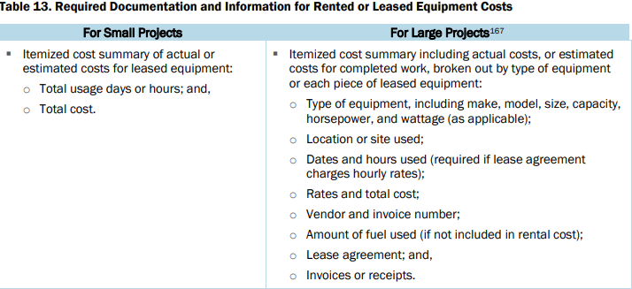
Force Account Equipment PAPPG v.5 pages 84-91
FEMA only applies equipment rates to the time the applicant is operating equipment.
Costs associated with mobilizing equipment to a project site are eligible
Costs for stand by time are not unless the equipment operator uses the equipment intermittently for more than half of the working hours for a given day. In this case the intermittent standby time is eligible.
FEMA generally provides PA funding for local equipment rates if they are properly documented and reasonable.
Eligible costs will be based on the language of the rental agreement
The applicant must document the reasons for the rental as well as the procurement process used

Slide 29
New Equipment Rates
New rates are for disasters declared on or after July 26, 2023
The rates on this Schedule of Equipment Rates are for applicant‐owned equipment in good mechanical condition, complete with all required attachments.
FEMA’s equipment rates are comprehensive, in that they include associated costs such as fuel and maintenance
https://www.fema.gov/sites/default/files/documents/fema_schedule-of-equipment-rates_2023.pdf
Notes:
Each rate covers all costs eligible under the Robert T. Stafford Disaster Relief and Emergency Assistance Act, 42 U.S.C. § 5121, et seq., for ownership and operation of equipment, including depreciation, overhead, all maintenance, field repairs, fuel, lubricants, tires, OSHA equipment and other costs incidental to operation. Standby equipment costs are not eligible.
Equipment must be in actual operation performing eligible work in order for reimbursement to be eligible. LABOR COSTS OF OPERATOR ARE NOT INCLUDED in the rates and should be approved separately from equipment costs.

Slide 30
Supplies and Materials PAPPG v.5 pages 88-91
The cost of supplies, including materials is eligible if:
Purchased and justifiably needed to effectively respond to and/or recover from the incident; or
Taken from the applicant’s stock and used for the incident
The applicant needs to track items taken from stock with inventory withdrawal and usage records.
FEMA provides PA funding for these items based on invoices, if available.
If invoices are not available for items used from stock, FEMA provides PA funding based on the Applicant’s properly documented, established method of pricing delivery.

Slide 31
Contracts PAPPG v.5 pages 91-99
FEMA reimburses costs incurred using three types of properly procured contract payment obligations:
fixed-price,
cost-reimbursement,
and, to a limited extent, time and materials (T&M).
FEMA does NOT reimburse costs incurred under a cost plus a percentage of cost contract or a contract with a percentage of construction cost method
FEMA does NOT reimburse costs incurred under a lump sum contract in which eligible and non-eligible work was completed under that contract

Slide 32
Small and Large Project Thresholds PAPPG v.5 pages 255-256
Minimum Project Threshold: $4,000
Large Project Threshold: $1,062,900
Small projects are written, and the Federal Share paid, based on estimates (or actuals if work is completed when the project writing begins)
Large projects are written on estimates, but paid out based on actual costs…(with the exception of certain types of capped projects)
This change in the large project threshold is a result of a rules change published in the Federal Register, August 3, 2022.
United States, Department of Homeland Security. “Public Assistance Program’s Simplified Procedures Large Project Threshold.” 87 Fed. Reg. 47,359

Slide 33
Small Projects PAPPG v.5 page 255
Small projects are any projects written with a cost up to $1,062,900
For eligible projects, the State will cost-share up to 50% of obligated project non-federal share based on documented, validated costs
Documentation must be submitted and validated for cost-share to be paid out.
All projects must be inspected to verify completion of approved scope of work prior to any state share payment being made
All small project documentation must be kept for potential federal and state audit
Estimated | Actual | Actual
$1,062,900 SA total | $900,000 SA Total | $1,200,000 SA Total
$797,175 Fed Share | $797,175 Fed Share | $797,175 Fed Share
$132,862.50 State Share | $51,412.50 State Share | $132,862.50 State Share
$132,862.50 Local Share | $51,412.50 Local Share | $269,962.50 Local Share

Slide 34
Small Projects PAPPG v.5 page 255
FEMA only adjusts the approved amount on individual Small Projects if one of the following conditions applies:
The Subrecipient did not complete the approved SOW;
The Subrecipient requests additional funds related to an eligible change in SOW; or
The Project contains inadvertent errors or omissions.
In these cases, FEMA only adjusts the specific cost items affected.
If the actual total combined cost of all a Subrecipient’s Small Projects exceeds the total amount obligated for all Small Projects, the Subrecipient may request additional funding through a Net Small Project Overrun Appeal. The Subrecipient must request the additional funding through the appeal process within 60 days of work completion on its last Small Project. The appeal must include actual cost documentation for all Small Projects.

Slide 35
Procurement and Contracting Requirements PAPPG v.5 pages 91-99
Applicants must comply with Federal procurement standards as a condition of receiving PA funding for contract costs for eligible work. Federal procurement standards for State and Territorial governments are different than those for Tribal and local governments and PNPs.
States and Territorial Governments:
Follow the same policies and procedures they would use for procurements with non-Federal funds
Comply with 2 CFR § 200.322, Procurement of recovered materials
Ensure that every purchase order or other contract includes any clauses required by 2 CFR § 200.326, Contract provisions (See Appendix K of the PAPPG, v4)
Non-State Applicants (Tribal, Local Governments and PNPS)
Must use their own documented procurement procedures that reflect applicable State, Territorial, Tribal, and local government laws and regulations, provided that the procurements conform to applicable Federal law and standards
Notes:
Note 1- Must have documented procurement procedures
Note 2- Most strict, whether that is state, federal, or local

Slide 36
Procurement, Continued
Must comply with the following federal standards:
1. Provide full and open competition;
2. Conduct all necessary affirmative steps to ensure the use of minority businesses, women’s business enterprises, and labor surplus area firms when possible;
3. Exclude contractors that develop or draft specifications, requirements, statements of work, or invitations for bids or requests for proposals from competing for such procurements to ensure objective contractor performance and eliminate unfair competitive advantage;
4. Maintain written standards of conduct covering conflicts of interest and governing the performance of employees who engage in the selection, award, and administration of contracts;
5. Be able to provide:
Rationale for the method of procurement
Selection of contract type
Contractor selection or rejection
The basis for the contract price
Notes:
Tribal and local governments and PNPs must conduct procurement transactions in a manner that complies with the following Federal standards
Provide full and open competition
Conduct all necessary affirmative steps to ensure the use of minority businesses, women’s business enterprises, and labor surplus area firms when possible…
Non-state applicants must engage these categories of socioeconomic firms in the procurement process, but are not required to set aside awards for them. To engage them in the procurement process, non-state applicants MUST take the following affirmative steps (§ 200.321):

Slide 37
Procurement Methods
Micro-purchase
≤$10,000 or comparable state/local/tribal threshold, whichever is lower
Requires only ONE quote if price is reasonable
MUST distribute equitably among vendors
Small purchase procedure
≤$250,000 or comparable state/local/tribal threshold, whichever is lower
Requires quotes from an “adequate number” of qualified sources
Sealed Bidding
Preferred method for construction contracts
Firm-fixed-price contract is awarded to the lowest priced, responsive, responsible bidder
Non-state applicants must solicit bids from an adequate number of suppliers
Local and tribal governments must publicly advertise the invitation for bids and open bids publicly
Competitive Proposals
Method generally used when conditions are not appropriate for sealed bidding
Fixed price or cost reimbursement contract is awarded to the responsible firm whose proposal is most advantageous to the non-state applicant
Non-state applicants must publicize requests for proposals (RFPs), and solicit proposals from an adequate number of qualified sources
RFPs must identify all evaluation factors and their relative importance

Slide 38
Non-competitive Proposal
FEMA may reimburse costs incurred under a contract procured through a noncompetitive proposal only when one or more of the following apply, and the reason for the exemption is thoroughly documented:
The item is only available from a single source;
The public exigency or emergency for the requirement will not permit a delay resulting from competitive solicitation;
FEMA or the Recipient expressly authorizes a noncompetitive proposal in response to a written request from the Applicant; or
After solicitation of a reasonable number of sources, competition is determined inadequate
Notes:
Tribal or local governments and PNPs must perform a cost or price analysis in connection with every procurement action in excess of the simplified acquisition threshold, including contract modifications. The method and degree of analysis depends on the facts surrounding the particular procurement situation. As a starting point, the Applicant must make independent estimates before receiving bids or proposals

Slide 39
Exigent or Emergency Circumstances PAPPG v.5 page 97
Federal regulations allow for noncompetitive procurement under certain circumstances:
Exigency: When there is need to avoid, prevent, or alleviate serious harm or injury, financial or otherwise, to the non-state entity, and the use of competitive procurement proposals would prevent the urgent action required to address the situation.
Emergency: When a threat to life, public health or safety, or improved property requires immediate action to alleviate the threat.
Emergency conditions are normally short lived, while exigent circumstances can exist for weeks or months
Emergency or exigent circumstances do not automatically apply just because this is a declared disaster
Because the exception to competitive procurement is available only while the exigent or emergency circumstances exist, applicants should, upon awarding a noncompetitive contract, immediately begin the process of competitively procuring similar goods and services in order to transition to the competitively procured contracts as soon as the exigent or emergency circumstances cease to exist.
Please review the following FEMA Fact Sheet for more details:
https://www.fema.gov/news-release/2020/03/20/procurement-under-grants-under-exigent-or-emergency-circumstances

Slide 40
Frequent Sources Of Non-compliance
Time and Materials Contracts
Cost-Plus-Percentage-of-Cost Contracts
Piggybacking
Geographic Preferences
Awarding to Contractors that Drafted Solicitation Documents
Use of Suspended or Debarred Contractors
Failure to comply with proper procurement procedures will result in a loss of some or all of the funding associated with the services and/or materials purchased

Slide 41
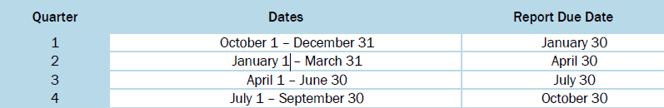
Quarterly Report Requirements PAPPG v. 5 pages 251-252
Timely completion and submission of quarterly reports is a condition of the Public Assistance Grant
Standard Lane projects will be listed on every report until the applicant is closed
Completed quarterly reports must be submitted to ensure proper payment as well as proper project deadlines are being met.
Failure to complete and submit quarterly reports in a timely manner may jeopardize funding

Slide 42
Management Costs (Category Z)
Management Costs for each applicant will be on a single Category Z project.
Management Cost Project will be closed and paid on actual expenses, up to 5% of the total eligible project costs.
Under current policy, volunteer work cannot be used to claim Management Costs.
The Category Z project is subject to the same validation requirements as all other projects.
Documentation Requirements:
An explanation of work performed with a representative sample of daily logs/activity reports. The activity must be related to eligible projects.
Documentation to substantiate the necessity of any claimed office supplies, equipment, or space.
For meetings or site inspections, the activity description needs to include the number and purpose of the meetings or site inspections.
Travel costs need to include the purpose of travel and a copy of the travel policy.
Training needs to include the location, date(s), and title of the course. The training must be related to PA and occur within the period of performance of the Category Z PW.
Recipients and Subrecipients need to certify that the management activities and associated costs claimed are eligible, consistent with policy, and not related to ineligible projects.

Slide 43
SO, WHAT COMES NEXT?

Slide 44


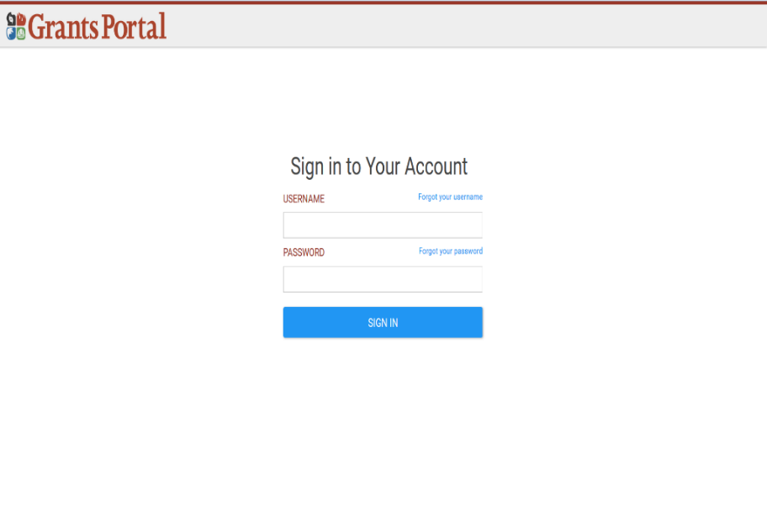
Grants Portal
Web-based tool through which all FEMA project documentation and determinations will flow.
Track all projects, documentation, and information through portal- live site, 24/7
Upload documentation even before a disaster declaration such as:
Pay Policy
Insurance Policy
Procurement Policy
Equipment Inventory List
Each applicant can have one or more registered users
Registered users may have different roles and rights

Slide 45
Initial Applicant Account Creation
ALL applicant organizations are required to have an account- this is not optional
If you already have an account, you do not need to create a new one for this disaster
If you are not sure whether you already have an account, please check with a member of NEMA’s PA team
Grants Portal now has a feature that allows potential applicant agencies to create their own account. Please work with NEMA before doing that to ensure that it is done properly
All emails come from support.pagrants@fema.gov; please check your junk/spam folder if you do not receive an invite in your inbox

Slide 46
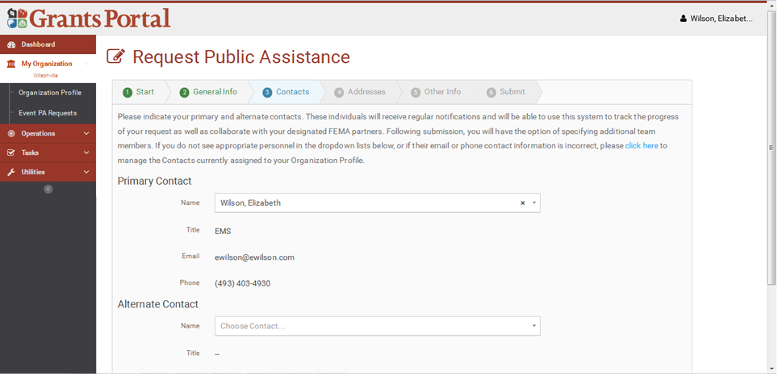
Request For Public Assistance (RPA)
RPA is the formal acknowledgement of applicant’s intent to request reimbursement from the FEMA Public Assistance Program.
RPAs must be completed and submitted electronically in Grants Portal by June 20, 2025.

Slide 47
Public Assistance Program Delivery
The Public Assistance Delivery Model has four phases, each with its own objective. Breaking the model up into phases allows for greater transparency and tracking of Applicants' grants.
Phase I: Operational Planning Objective: Identify Applicants' disaster impacts and recovery priorities.
Phase II: Damage Intake & Eligibility Analysis Objective: Capture Applicants' disaster-related damages and determine eligibility within 60 days of the Recovery Scoping Meeting.
Phase III: Scoping & Costing Objective: Develop the Damage Description and Dimensions, scope of work, and actual costs for Completed/Fully Documented projects, or develop the scope of work and cost estimates for Standard and Specialized projects. The Consolidated Resource Center also validates Applicant-provided scope of work and cost estimates.
Phase IV: Obligation Objective: Obligate projects, complete the Recovery Transition Meeting with the Applicant, and transition Field Operations to the Region.

Slide 48
Program Delivery Manager (PDMG)
PDMG is primary FEMA POC for applicants
Works closely with state recovery staff
Each PDMG assigned 5-7 applicants (dependent on size and scope of disaster)
Assigned after RPA is approved by FEMA
Works at Joint Field Office (JFO) (Most likely in a virtual environment)
Key PDMG responsibilities:
Conduct meetings
Assist with documentation upload into Grants Portal
Grants Portal troubleshooting
Coordinate between FEMA staff, state staff, and applicant
Request site inspections
Identify and troubleshoot any/all questions or concerns
Notes:
FEMA will assign a Program Delivery Manager (PDMG)–a single point-of-contact assigned to each applicant—who will provide assistance to the applicant throughout the application process.

Slide 49
Exploratory Call (EC)
PDMG conducts Exploratory Call within 7 days of applicant assignment, and it is designed to:
Introduce the PDMG to the applicant
Discuss damages at a high level
Discuss documentation that will be needed for the Recovery Scoping Meeting
Schedule date/time for Recovery Scoping Meeting
When you are scheduling the RSM, please work to ensure the meeting includes the people who most understand the needs of the damaged facilities
Notes:
The PDMG will conduct an Exploratory Call with assigned applicant representatives to obtain general information about the applicant and its disaster impacts, and to explain next steps. ✓
Applicant representatives should be prepared to discuss impacts and provide the names of counterparts who may be involved.
Applicant representatives will learn more about the PA Grants Portal, the online database used to manage grant applications and upload required documents.

Slide 50
Recovery Scoping Meeting (RSM)
PDMG conducts RSM within 21 days of applicant assignment
The RSM is designed to:
Be the first formal, in person meeting between PDMG, applicant, and state
Review and discuss all disaster related damages
Determine need for site inspections
Identify all potential or actual Environmental/Historic Preservation, Mitigation, and Insurance questions or concerns
Introduce the Damage Inventory spreadsheet
Determine Essential Elements of Information
Comprehensive list of required documentation for each type of damage/work
Assist with documentation upload into the Grants Portal
Develop correspondence schedule
The RSM Starts the 60-day clock for Damage Identification

Slide 51
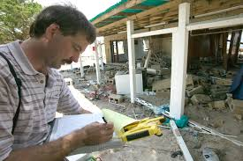
Site Inspections (SI)
PDMG will schedule site inspections for all work not complete at time of Recovery Scoping Meeting
A Site Inspector will be dispatched to meet with applicant and view incomplete work
SI records detailed information
Latitude/Longitude
Photos
Dimensions of damage
Report of all damage will be created from each site inspection
Report must be reviewed and approved in Grants Portal by PDMG and applicant
Notes:
Standard and specialized inspections are arranged by the FEMA Site Inspection Task Force Leader, in coordination with the PDMG and the applicant.

Slide 52
Project Worksheets
Project Worksheets (PWs) will indicate:
The Damage Description and Dimensions (DDD), which is the damage the project is intended to repair.
The Scope of Work (SOW), which indicates the approved work completed/to be completed to make the needed repairs to return the facility to pre-disaster condition.
Work associated with approved Hazard Mitigation, or codes and standards will be clearly identified.
The approved cost for the repairs indicated in the PW.
If the work has been completed and you have provided all the related documentation to FEMA during project development, the project will be written based on actual costs.
If the work has not been completed, the project will be written with estimates and will indicate contract labor. That does not mean you need to contract the work out, that is just how FEMA does their estimates.
Before final approval of the project, or obligation, it is your responsibility as the applicant to thoroughly review every part of your project(s) to ensure everything you discussed with the FEMA staff appears in it to your satisfaction.

Slide 53
Consolidated Resource Center (CRC)
CRC’s employs full-time project writing staff
Projects formulated from Damage Inventory Sheet → Damages logically grouped
FEMA reviews will be conducted at the CRC
Applicant signs off (approves) project(s) after development and validation at the CRC
100% complete work
Work to be completed
CRC’s will write Damage, Description and Dimensions (DDD) and Scope of Work (SOW) based upon information in Grants Portal
Site Inspector will write DDD; CRC writes SOW
Notes:
Consolidated Resource Centers, which are centralized locations where subject matter experts are staffed to process grant applications across multiple disasters- so essentially, projects will be written the same in Texas as they are Oregon and Nebraska.
There shouldn’t be delineation in project quality depending on who is staffing the Joint Field Office.

Slide 54
Project Formulation APPROVALS:
At several points along the process, the applicant will be asked to sign documents for approval, typically through the Grants Portal platform
After the Site Inspection, if needed,
After the DDD (Damage Description and Dimensions) report is completed, and
After the project is written and a Scope of Work and Cost are developed, the Applicant will have an opportunity to review and sign the document
Whenever there is an opportunity to sign and approve something, there is also the opportunity to send it back for review and correction if you disagree. If something does not look right at any step, ask whatever questions you have, and be sure you understand the answers, before you sign it and move it forward.
If you feel like you are being pressured to sign something just to move it forward, reach out to your NEMA Point of Contact before you sign it.

Slide 55
Closeout Phase
Complete the work, move the project to FEMA closeout, make final payments to applicant
Applicant completes the eligible work according to the FEMA-approved and obligated Project Worksheet (PW)
If the obligated Scope Of Work (SOW) needs to be changed, the applicant must work with NEMA staff to receive FEMA approval prior to commencing work.
Once the work is complete, the applicant will notify NEMA and provide to NEMA documentation summarizing and supporting all costs incurred to complete the project and demonstrating compliance with all conditions of the grant
NEMA will validate the required documentation, reaching out to the applicant to supply missing information
Once NEMA has validated the provided documentation, NEMA will seek concurrence from the applicant, then forward the closeout package to FEMA for final closeout

Slide 56
Applicant Responsibility
You are responsible for your own grant and for ensuring you follow the conditions of that grant, including:
Compliance with Federal, State, and Local procurement and EHP policies
Work was done according to the approved Scope of Work
Performing the work within the approved timeline
Requesting time extensions before your current deadline has passed
Submitting properly completed quarterly reports
Completely understanding the projects written for you before approving them for obligation
Timely and complete submission of documentation at all stages of the grant process
Prompt and complete response to Requests for Information (RFIs) from FEMA and NEMA
Proactive and responsive communication throughout the life of the grant
If you have any questions at any point, or require assistance, please contact a member of the NEMA PA team.

Slide 57
What We Need Now…
Grant Portal Account Creation
Please talk with one of the NEMA Staff here today to determine if you need one
Submit Request for Public Assistance (RPA) through Grants Portal
NEMA Staff can help with this
Submit required State forms directly to NEMA (found on our website/red folder- https://nema.nebraska.gov/recovery/public-assistance)
NEMA Risk Assessment
Applicant Information Form
Authorized Representative Form
Memorandum for the Record
Disaster Grant Agreement– currently not in your packets; will present at a later date
NEMA will not process payments without receiving all state forms from your entity.

Slide 58
NEMA Recovery Team
Donny Christensen
Recovery Section Administrator
Joel Beckman
Public Assistance Unit Supervisor
Lexy Hindt
Recovery Section Manager
Willow Nyman-Jones
State Public Assistance Officer
Erika Thompson Program Specialist I
Elizabeth Huggins Program Specialist I
Grant Ottinger Program Specialist I
Rachel Hines Program Specialist I
Sara Evans
Planning Specialist
Roena Morton Planning Specialist
Rebecca Blizzard Dept. State Public Assistance Officer
Braden Harris Planning Specialist
William Swett Planning Specialist

Slide 59
Recovery Staff Contact Information
For questions about Public Assistance: nema.publicassistance@nebraska.gov
Your email will be forwarded to the appropriate NEMA staff member, and they will reach out to you

Slide 60
THANK YOU!
Any questions?

